Slide 1


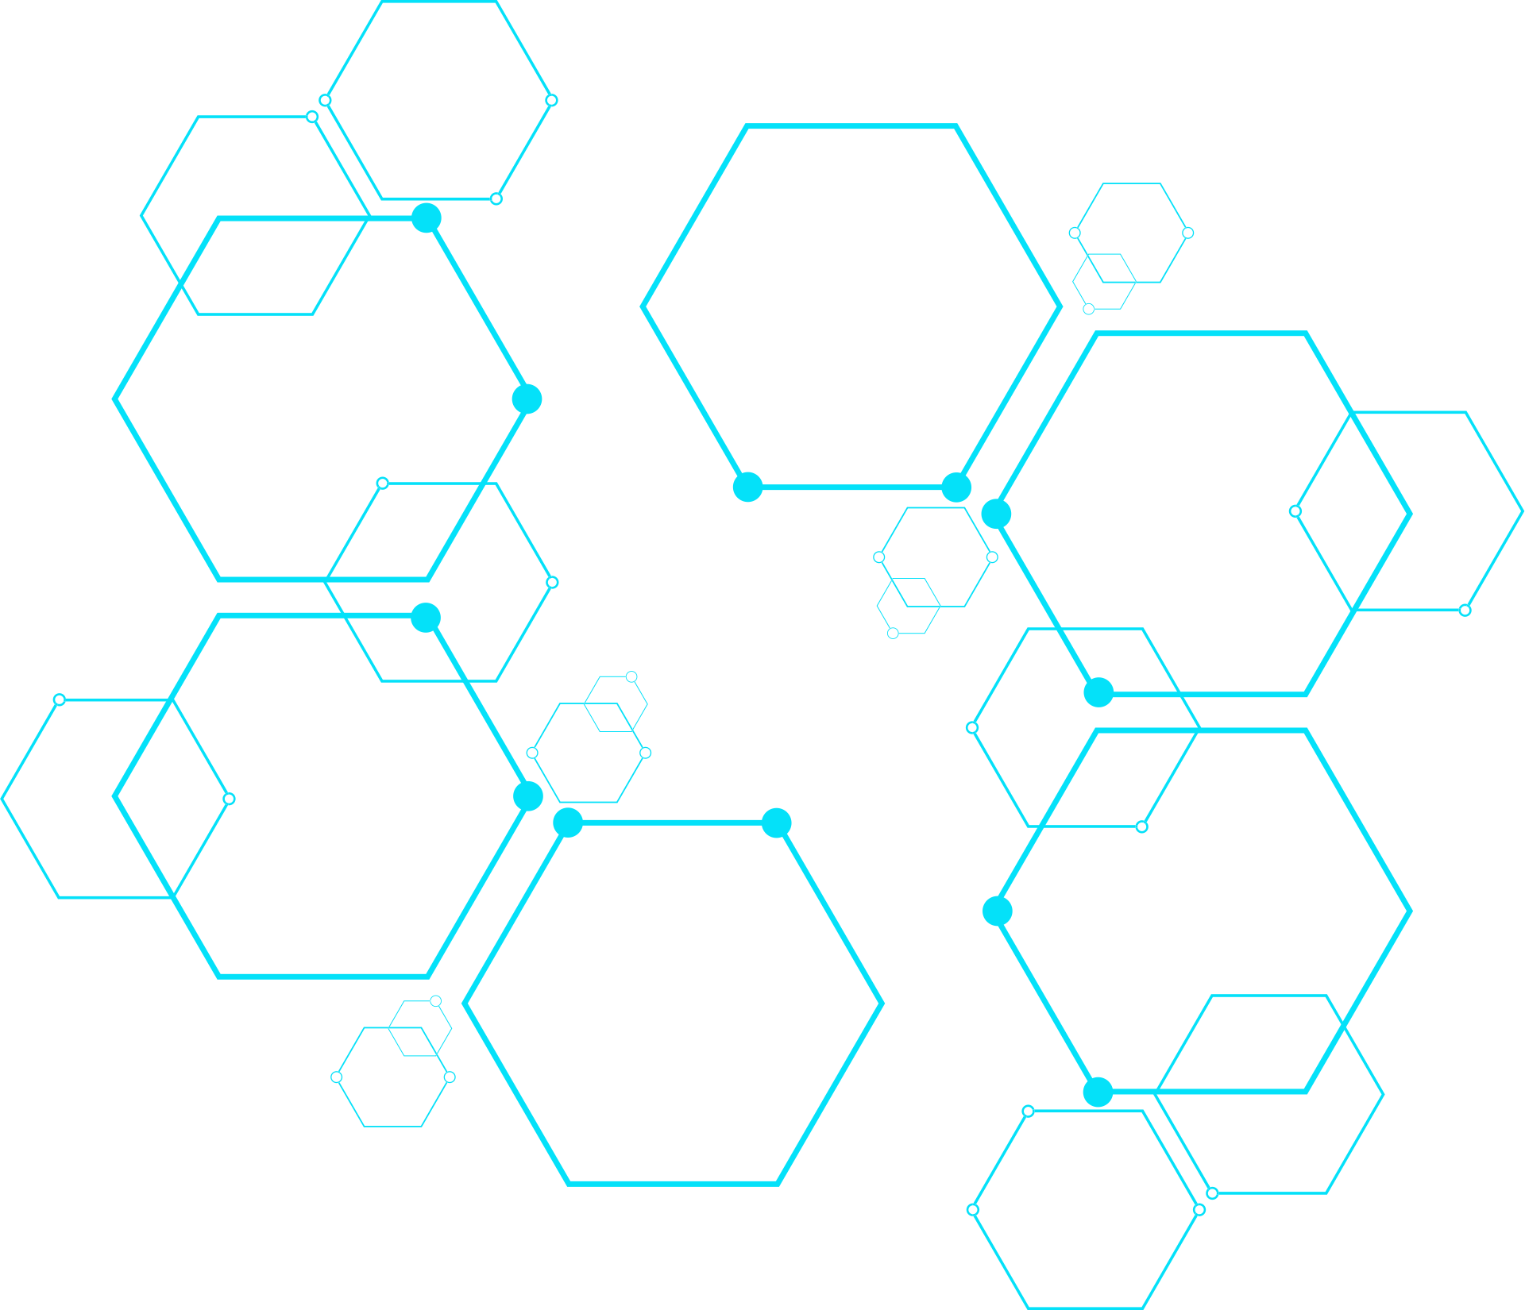
AI project:
Human Cancer Tissues
Farouk Faisal
Omar Medhat
Marwan Ashraf
Yousef Ashraf
Presented By

Slide 2

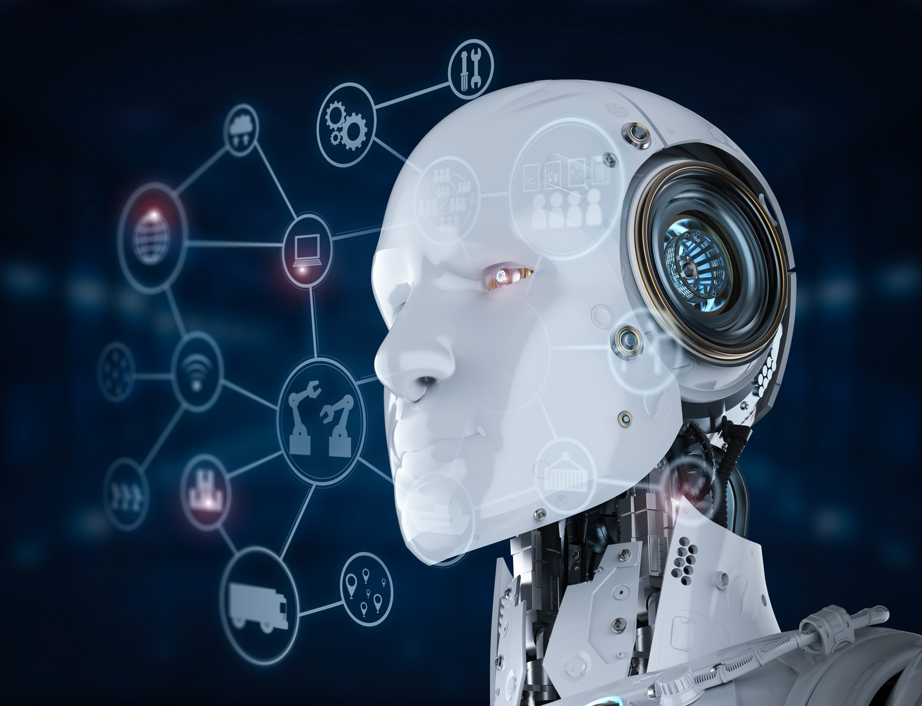
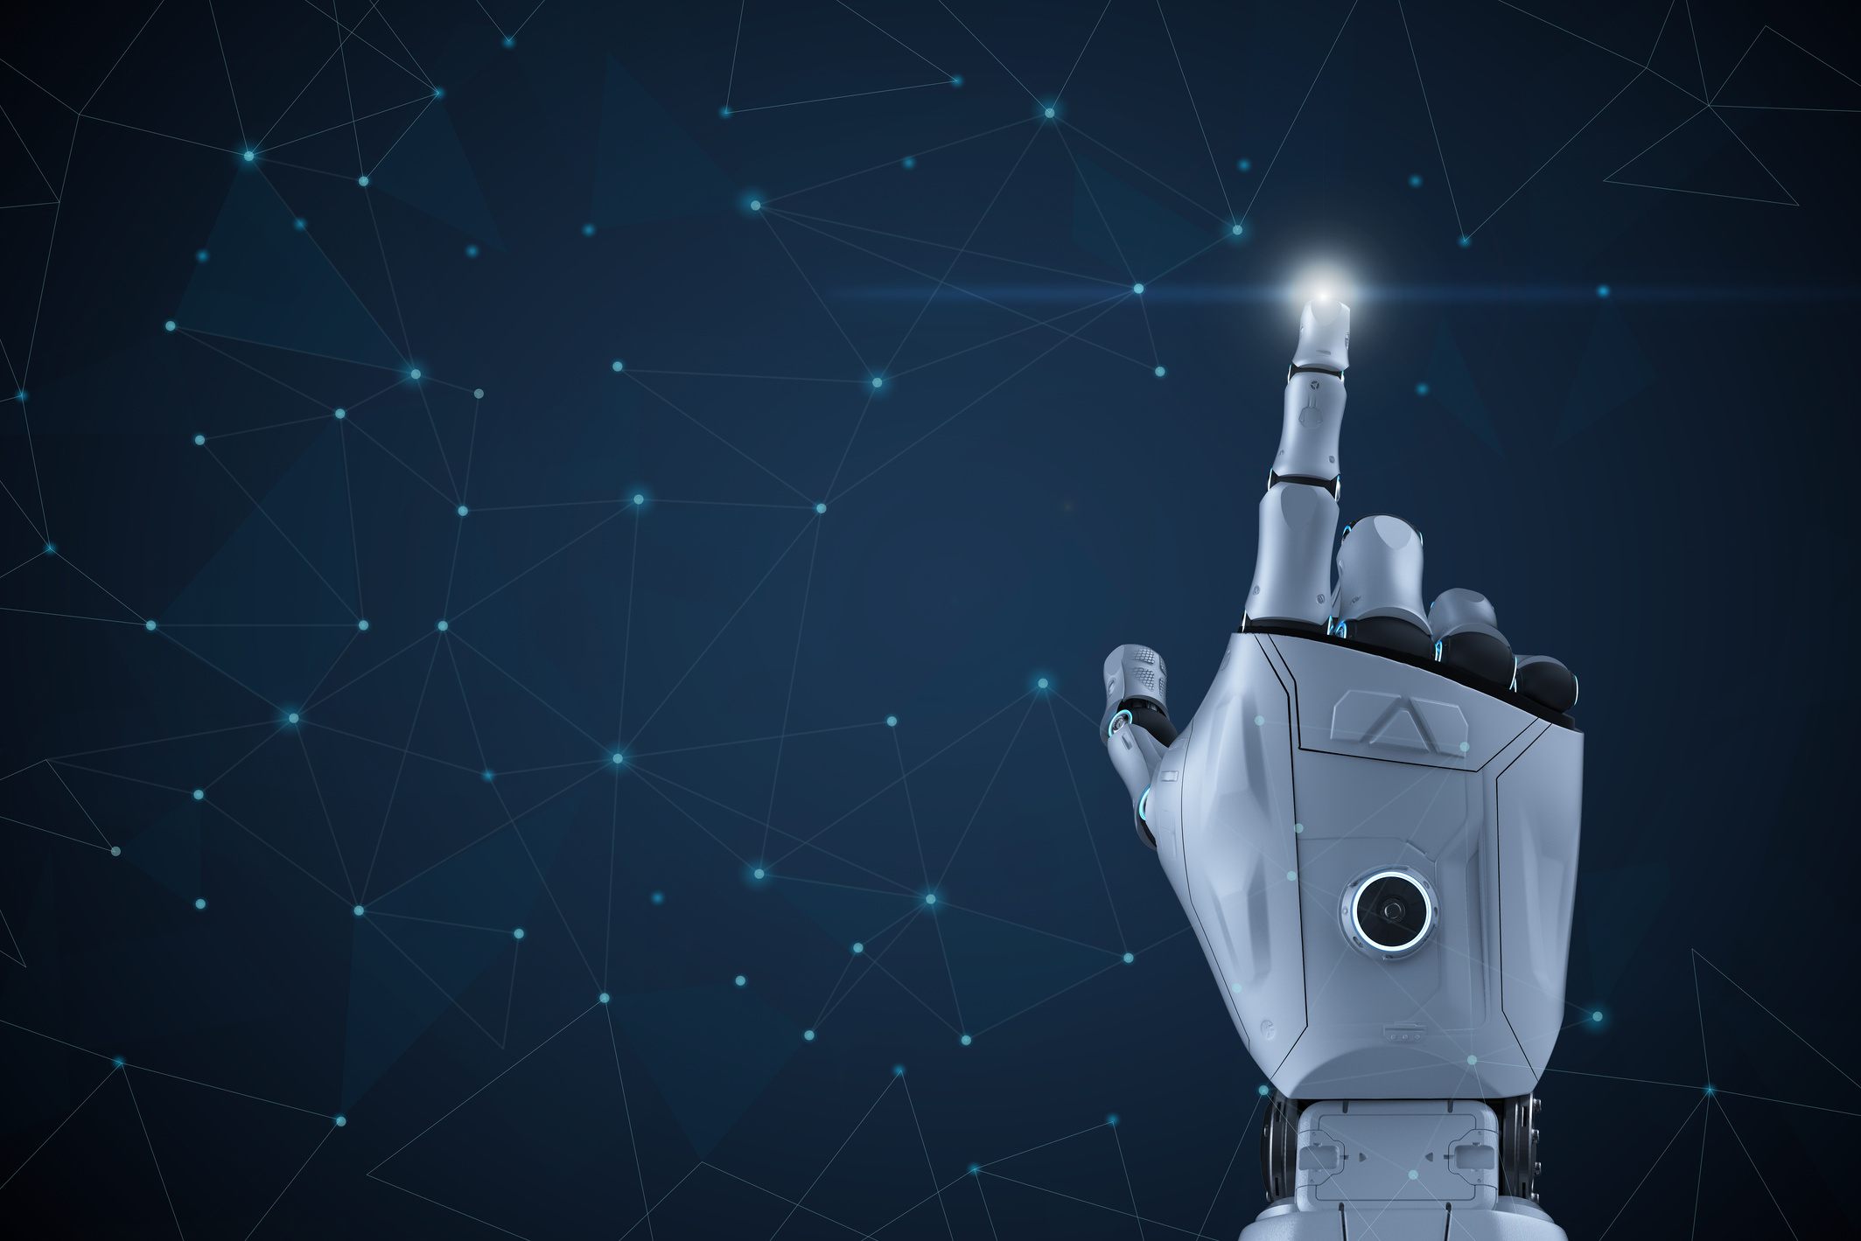
Introduction
This project uses a deep learning model (EfficientNetB5) to classify human cancer tissue images. It aims to accurately detect different cancer types from microscopic images. The dataset includes thousands of labeled samples, and the model was trained using TensorFlow and Keras. This helps improve the speed and accuracy of cancer diagnosis.

Slide 3
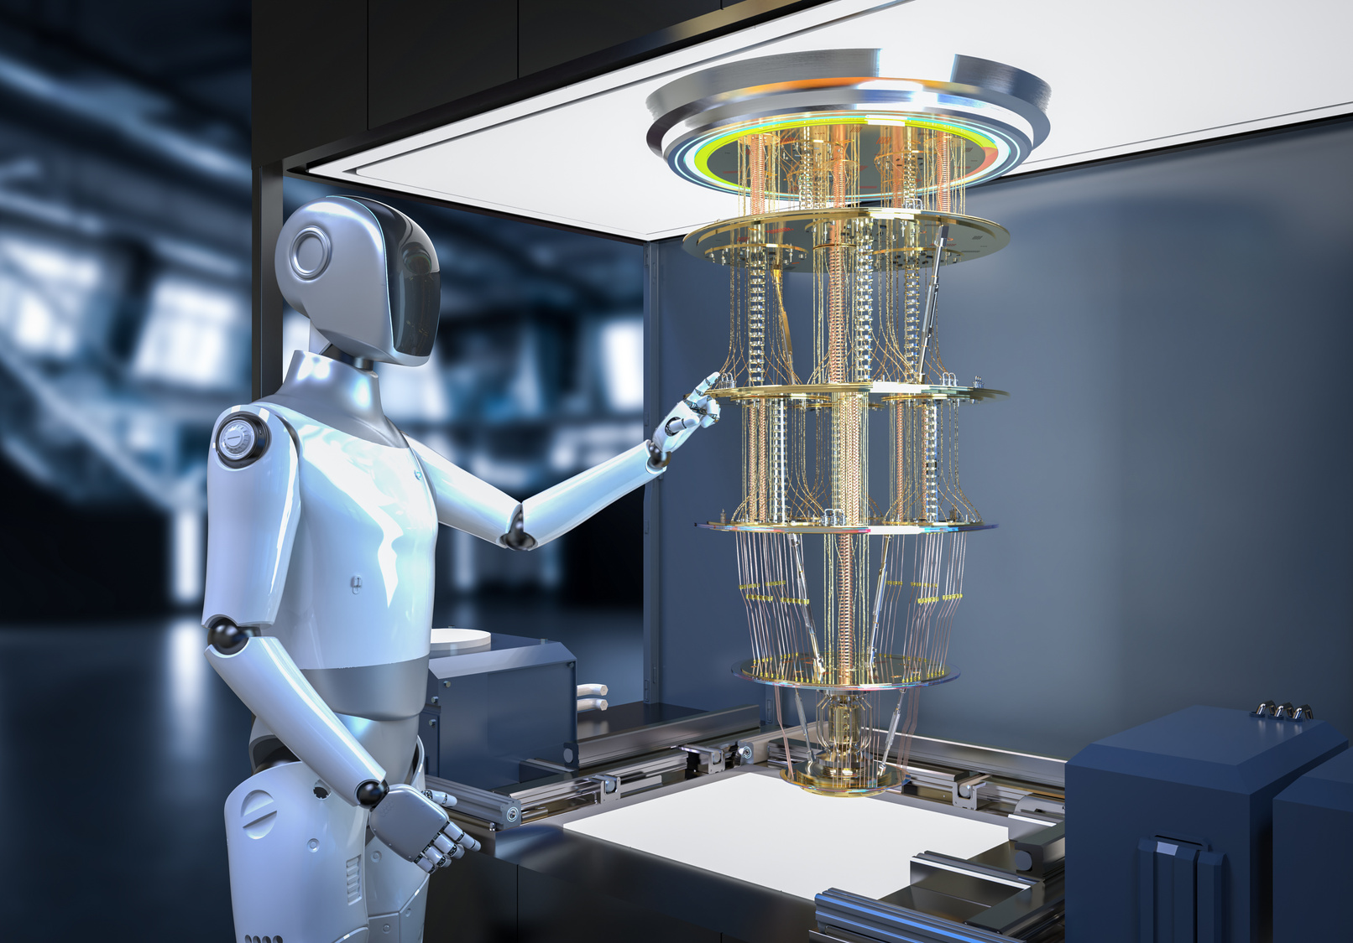
Data Analyst
The Data Analyst was responsible for exploring and analyzing the dataset before and after preprocessing. This included understanding the dataset structure, identifying patterns, visualizing data distribution, and supporting the team with data-driven insights.
Loaded and Explored Cancer Tissue Dataset
Analyzed Class Count and Distribution
Visualized Samples for Imbalance and Quality
Inspected Image Dimensions and Color Channels
Created Visualizations (Bar Plots & Grids)
Recommended Early Preprocessing Steps

Slide 4
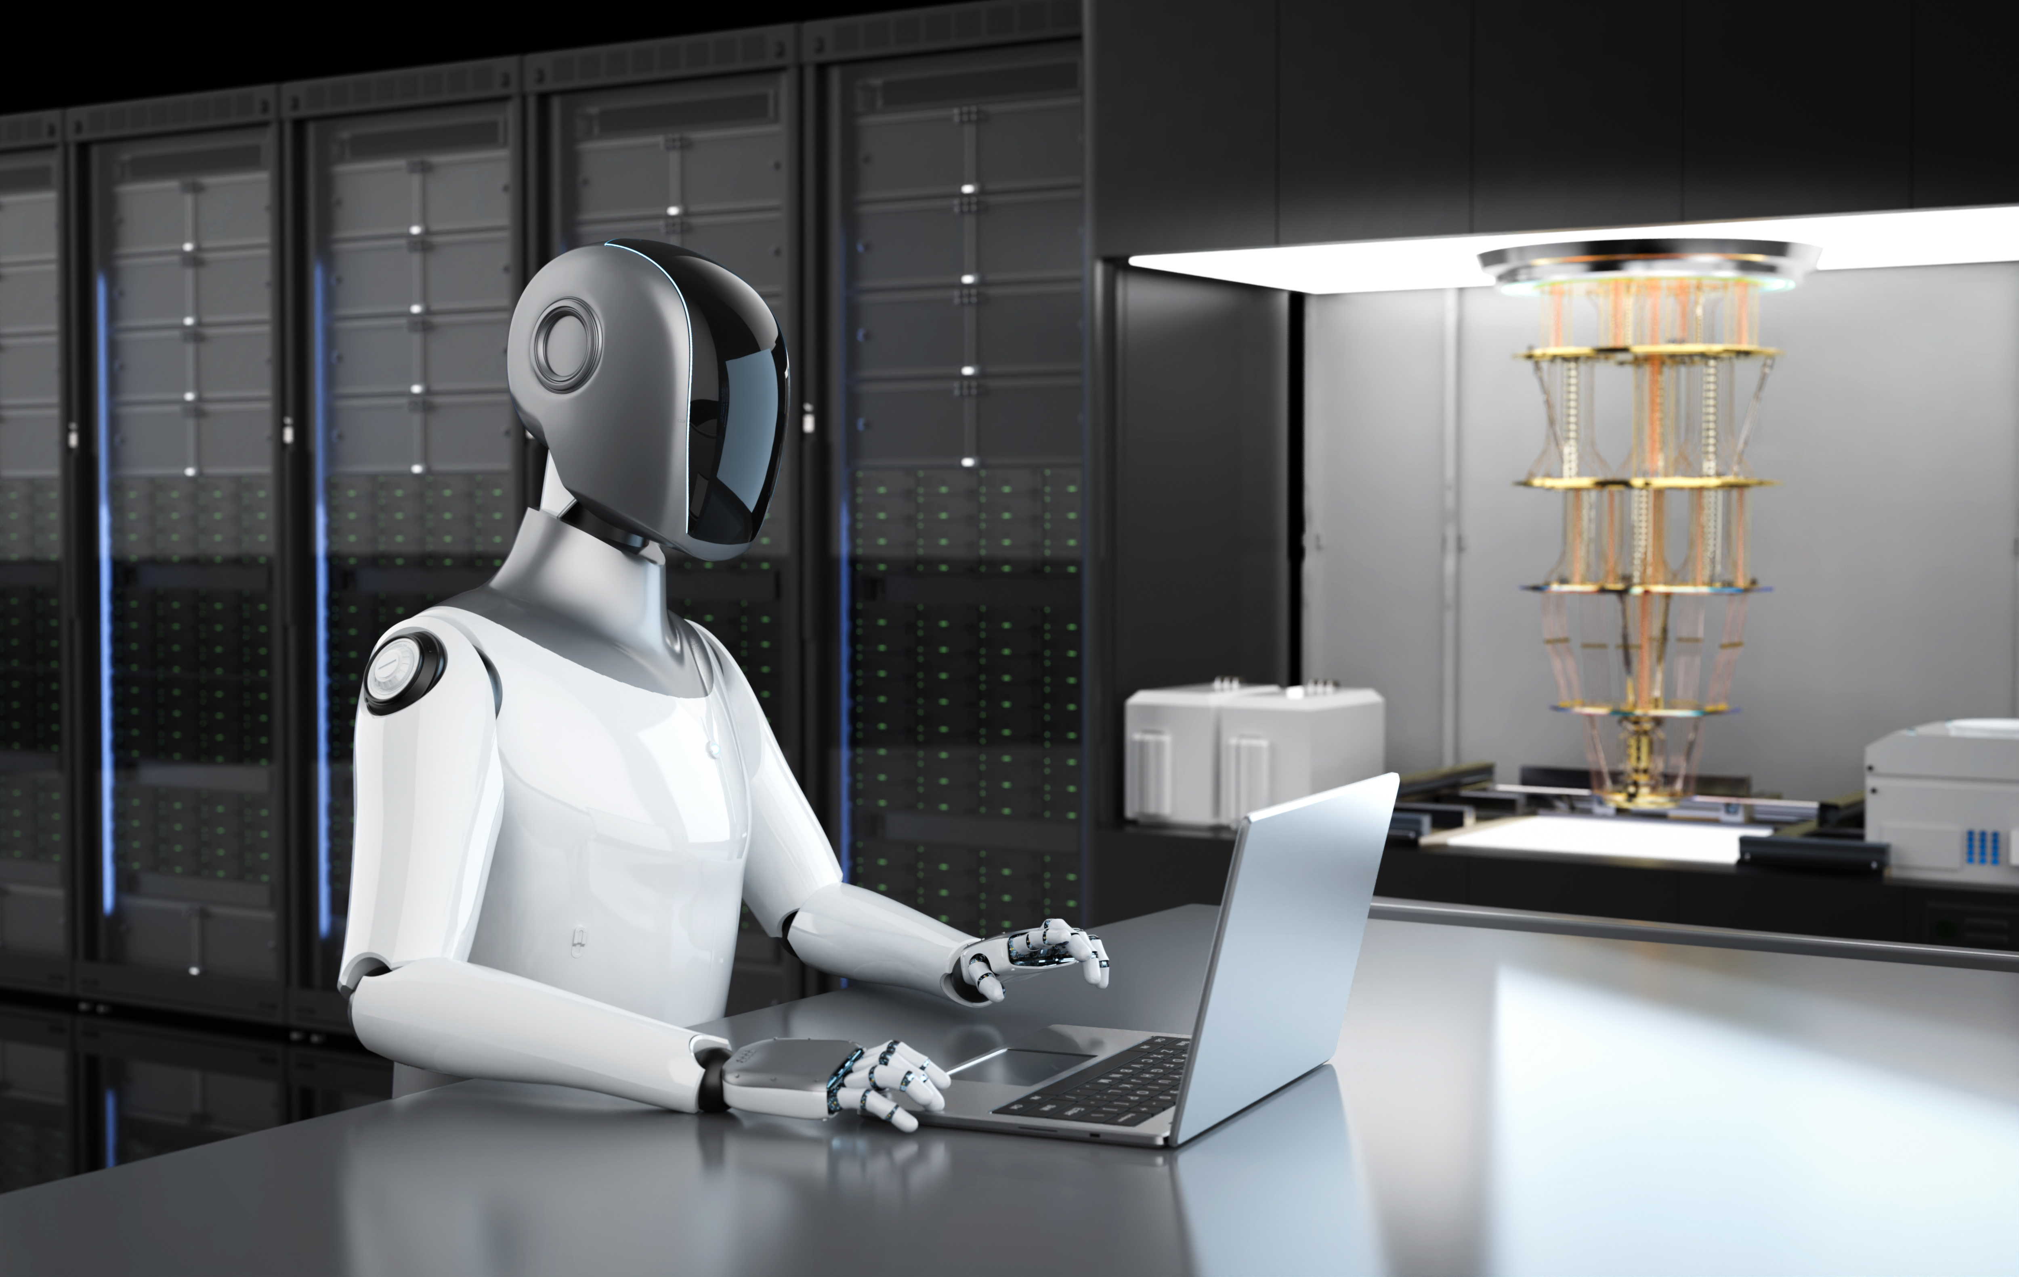
Data Engineer
The Data Engineer was responsible for cleaning, transforming, and preparing the data for model training. This includes applying preprocessing techniques like resizing, normalization, image conversion, and ensuring data consistency.
Verified Image Formats and Dimensions
Applied Preprocessing (Resizing, RGB Conversion, Normalization)
Prepared Training and Validation Sets with ImageDataGenerator
Organized Data into Cancer Class Subdirectories
Ensured Class Balance to Reduce Model Bias

Slide 5
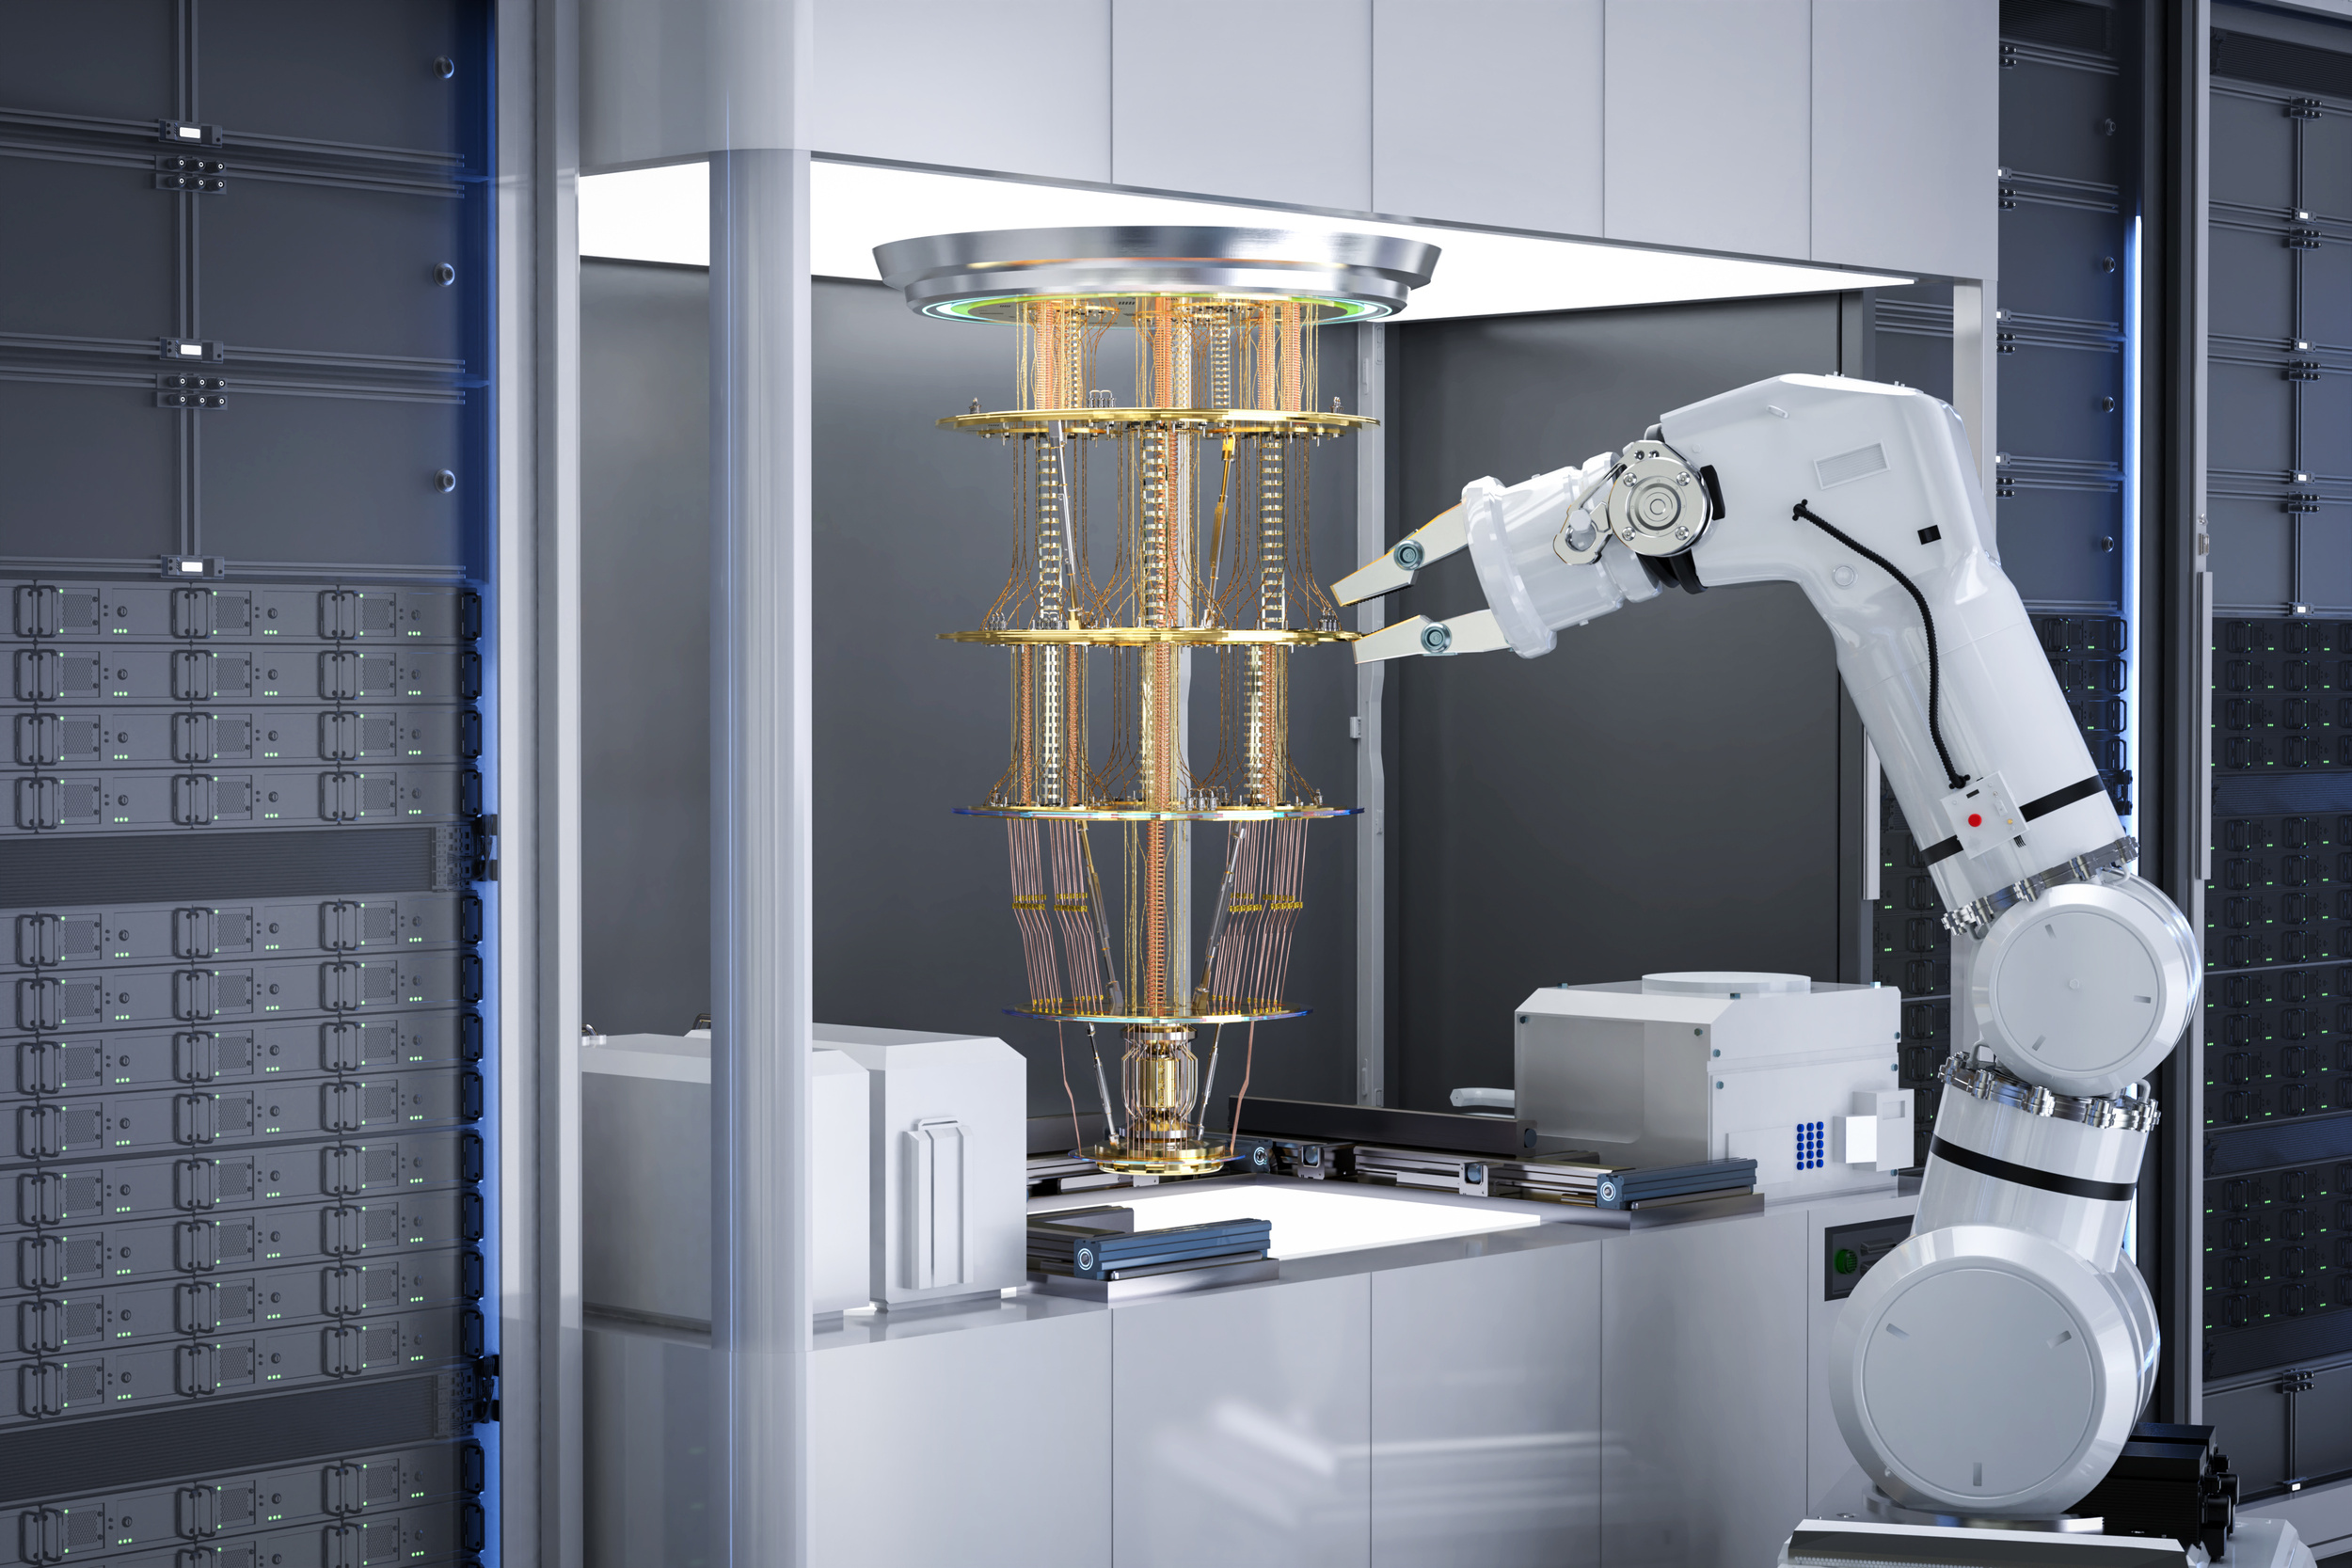
Machine Learning Engineer
The Machine Learning Engineer was responsible for building, training, and optimizing the deep learning model to achieve the best possible performance. EfficientNetB5 (pretrained) was used and customized for cancer tissue image classification.
Loaded EfficientNetB5 with Pretrained ImageNet Weights
Customized Top Layers for Classification Output
Applied Layer Freezing and Fine-Tuning
Selected Loss Function (categorical_crossentropy) , (accuracy)
Used Adam Optimizer with Learning Rate Tuning
Trained the Model and Evaluated on Validation Data

Slide 6
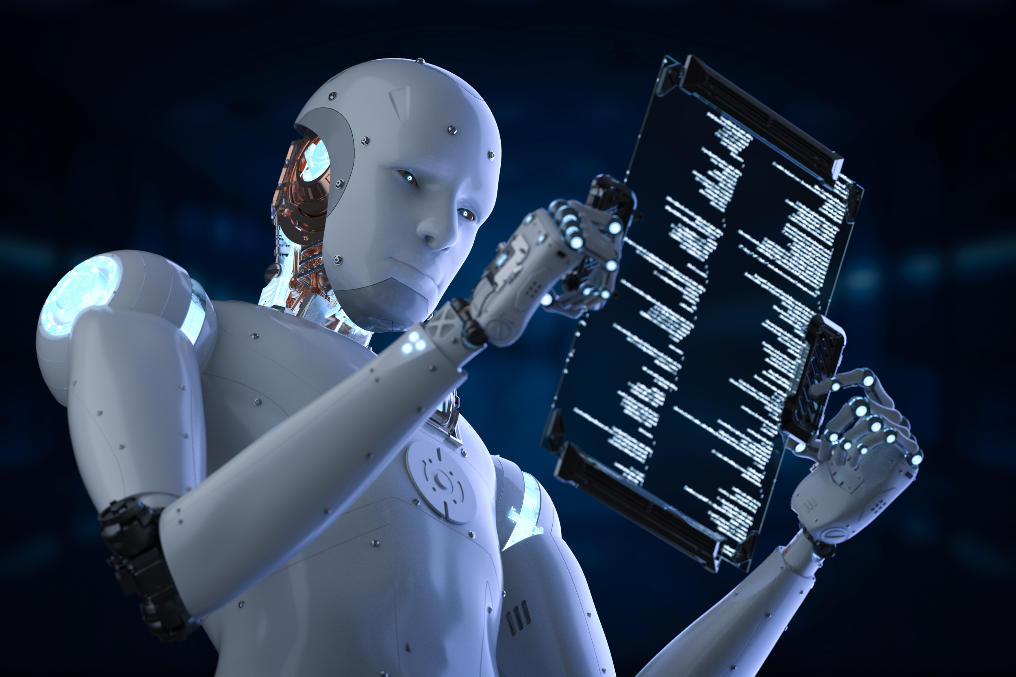
Evaluator /Metrics Analyst
The Evaluator / Metrics Analyst was responsible for evaluating the model’s performance using statistical metrics, interpreting the results, and identifying the model’s strengths and weaknesses in cancer classification.
Evaluated Model Using Validation Dataset
Calculated Overall Accuracy
Generated Confusion Matrix for Class-wise Analysis
Produced Classification Report (Precision, Recall, F1-Score)
Identified Misclassified Classes and Suggested Improvements

Slide 7
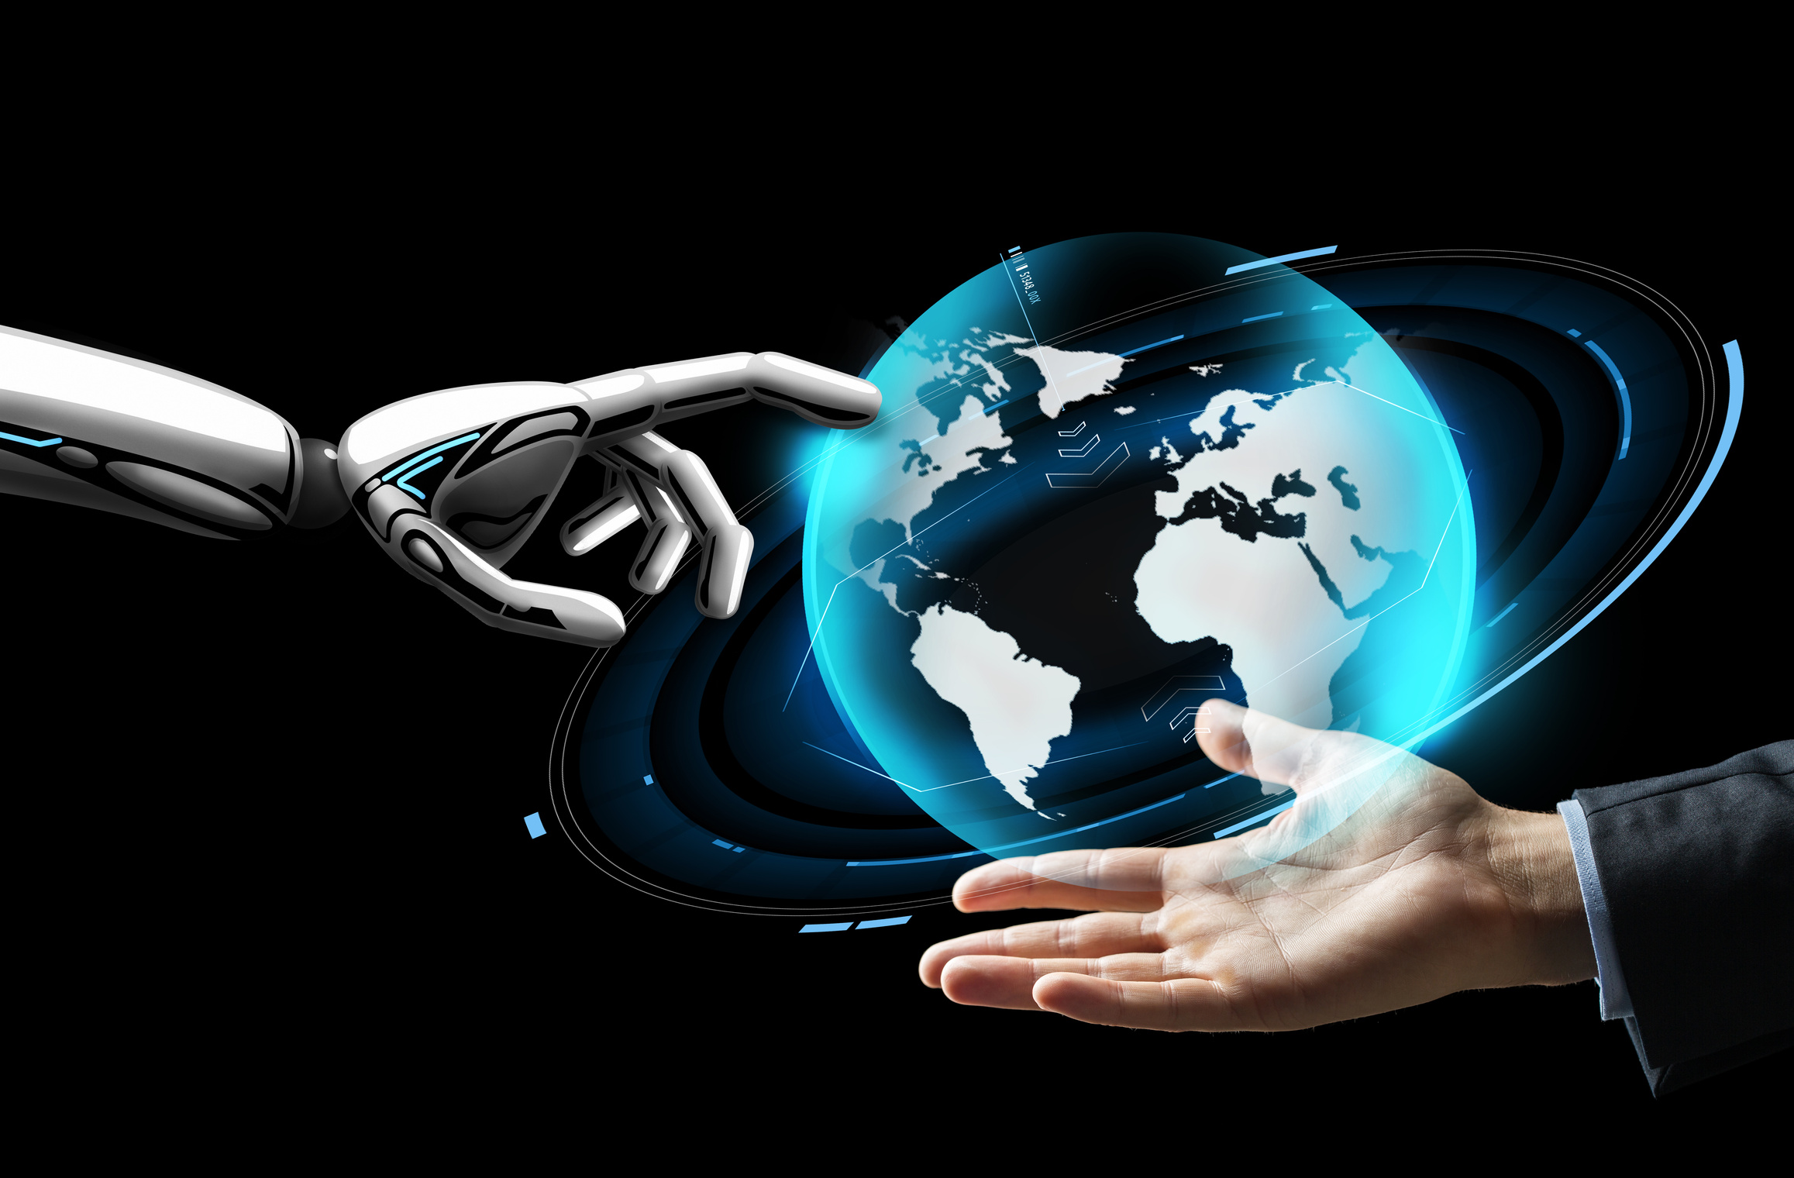
DevOps / Deployment Lead
The DevOps / Deployment Lead was responsible for uploading the project to GitHub, organizing code files, and deploying the trained model or results either locally or on an online platform to ensure accessibility and usability.
Structured Project Files in an Organized Directory
Uploaded Code and Final Model to GitHub with Full Documentation
Created README.md with Project Description and Requirements
Tested the Model Locally Post-Training
Deployed Model or Results via Google Colab or Streamlit
Verified Environment and Documented Deployment Steps

Slide 8
conclusion
In conclusion, the team successfully developed an end-to-end cancer tissue classification system using AI techniques, from data analysis to model deployment. This project highlights strong collaboration and precise execution, marking a valuable step toward intelligent medical diagnostics.

Slide 9
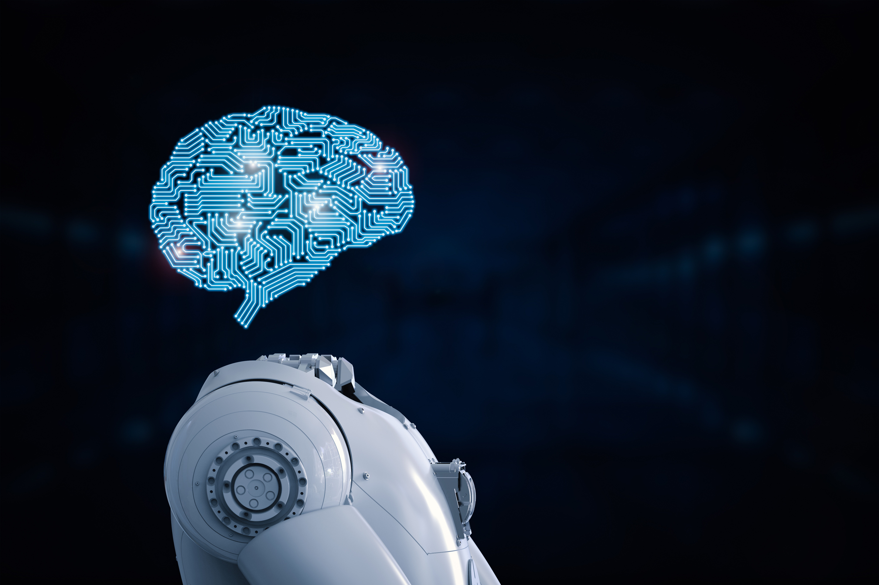
Thank You

